Slide 1
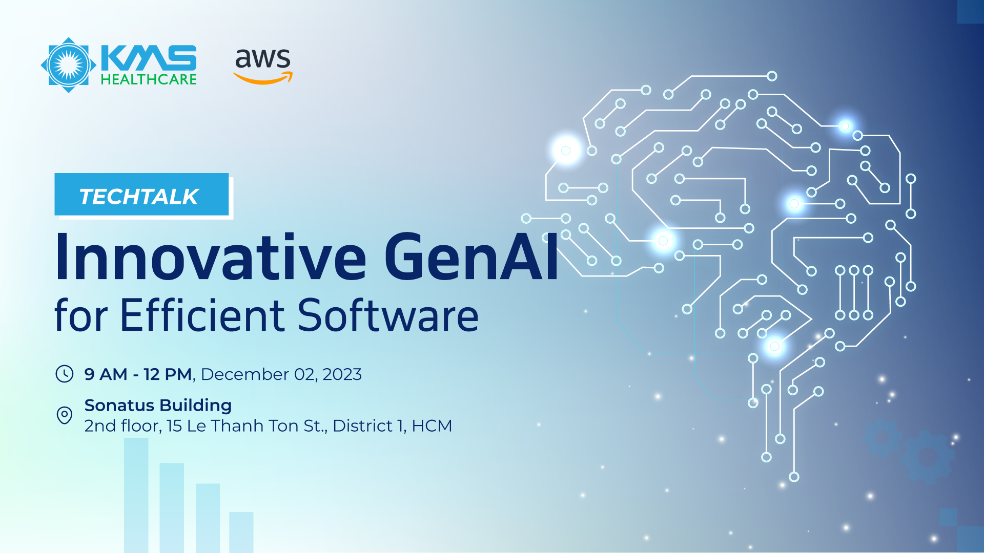

Slide 2




Session 1: Empowering RAG Applications with Agents

Slide 3


Empowering RAG Applications with Agents
Thi Nguyen
Solutions Architect
Amazon Web Services
© 2023, Amazon Web Services, Inc. or its affiliates. All rights reserved.

Slide 4






AGENDA
1
Fundamental Models (FMs) on Amazon Bedrock
2
Retrieval Augmented Generation (RAG)
3
RAG with Agents
4
Demo Stock Analysis Agent

Slide 5
Foundation Models
on Amazon Bedrock

Slide 6






Amazon Bedrock supports leading foundation models
Amazon Titan
Jurassic-2
Claude 2
Text summarization, generation, classification, open-ended Q&A, information extraction, embeddings and search
Multilingual LLMs for text generation in Spanish, French, German, Portuguese, Italian, and Dutch
LLM for conversations, question answering, and workflow automation based on research into training honest and responsible AI systems
Command and embed
Llama 2
Stable Diffusion
Text generation model for business applications and embeddings model for search, clustering, or classification in 100+ languages
Fine-tuned models ideal for dialogue use-cases and language tasks
Generation of unique, realistic, high-quality images, art, logos, and designs
Notes:
We believe in offering the best choice and flexibility of foundation models for your use cases.
We have our own Amazon Titan model, including Titan Text for text summarization, and our Titan Embeddings model for embeddings and search.
We offer AI21 Labs’s Jurassic-2, which uses natural language to generate text in a variety of languages.
Anthropic’s Claude is built with the latest research on responsible AI to perform conversational and text processing tasks.
Command, Cohere’s LLM, is a text generation model trained for business applications such as summarization, copywriting, dialog, extraction, and question answering
Fine-tuned versions of Llama 2 models from Meta are ideal for dialogue use-cases
Bedrock also supports Stability AI’s foundation models, including the widely popular Stable Diffusion model, which is capable of generating unique images, art and designs.

Slide 7

Jurassic 2
Jurassic-2 Mid
Jurassic – 2 Ultra
Mid-sized model, carefully designed to strike the right balance between exceptional quality and affordability. Jurassic-2 Mid can be applied to any language comprehension or generation task including question answering, summarization, long-form copy generation, advanced information extraction and many others.
AI21’s most powerful model offering exceptional quality. Apply Jurassic-2 Ultra to complex tasks that require advanced text generation and comprehension. Popular use cases include question answering, summarization, long-form copy generation, advanced information extraction, and more.
Max Tokens: 8,191
Max Tokens: 8,191
modelID: ai21.j2-mid-v1
modelID: ai21.j2-ultra-v1

Slide 8

Claude
Claude 2
Claude Instant
Anthropic's most powerful model, which excels at a wide range of tasks from sophisticated dialogue and creative content generation to detailed instruction following.
A faster and cheaper yet still very capable model, which can handle a range of tasks including casual dialogue, text analysis, summarization, and document question-answering.
Max Tokens: 100,000⁺
Max Tokens: 100,000 ⁺
modelID: anthropic.claude-v2
modelID: anthropic.claude-instant-v1
Claude 2.1 with limit at 200,000 Tokens or 150,000 words(500 pages)

Slide 9

How Amazon Bedrock works
Amazon Bedrock
Choose a FM
Use as is or customize
Send prompt
Receive response
Build generative AI applications using FMs through a serverless API service
Use the playground to experiment with FMs and select the one that suits your needs
Fine-tune FMs as needed; Bedrock will automatically deploy the FM for inference
Use Bedrock API to send your prompts to the model
Receive model response in your application

Slide 10
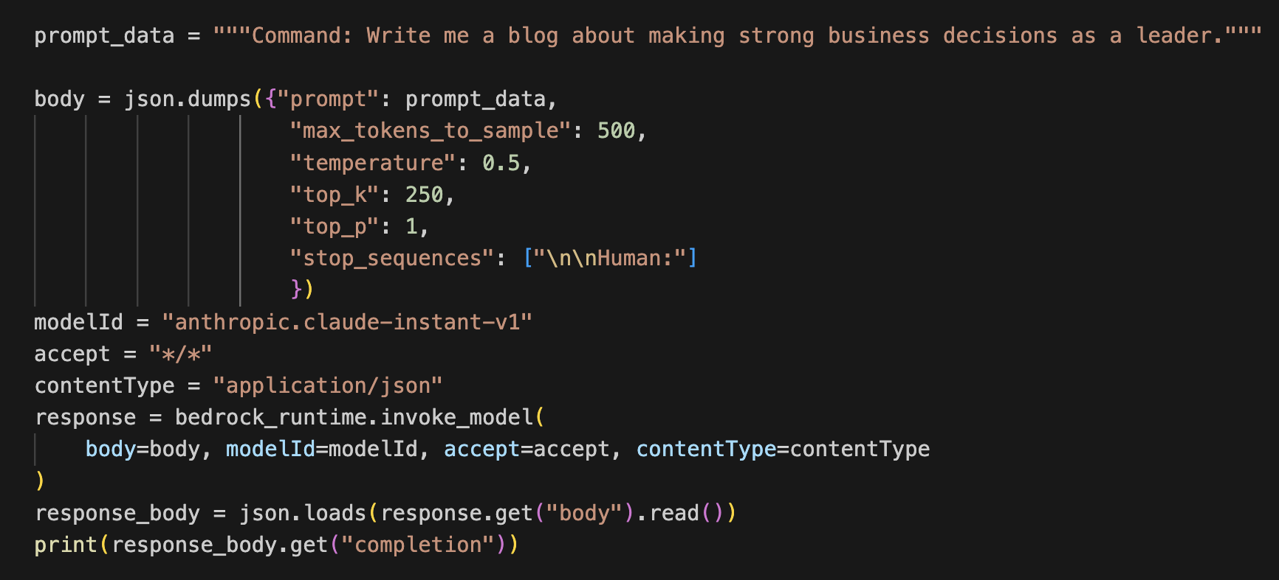
invoke_model() – Anthropic Claude

Slide 11
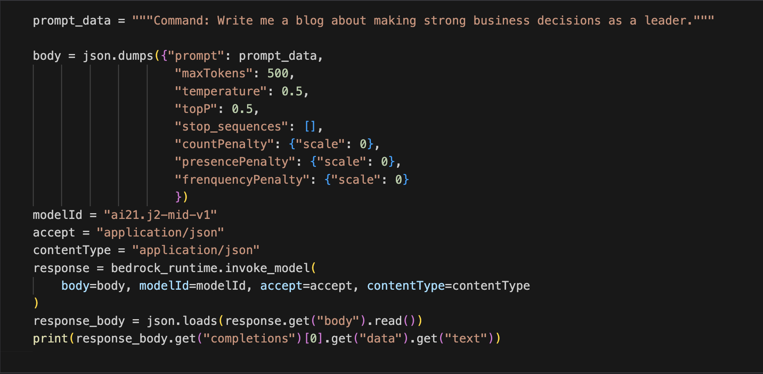
invoke_model() – AI21 Labs Jurassic-2

Slide 12
Retrieval Augmented Generation (RAG)

Slide 13
Can LLM models answer the following questions?
Can I know the stock value of Tesla today?
Tell me about revenue of Tesla?
What is the customer support Email/Phone?
How about the weather in Ho Chi Minh city today ?

Slide 14
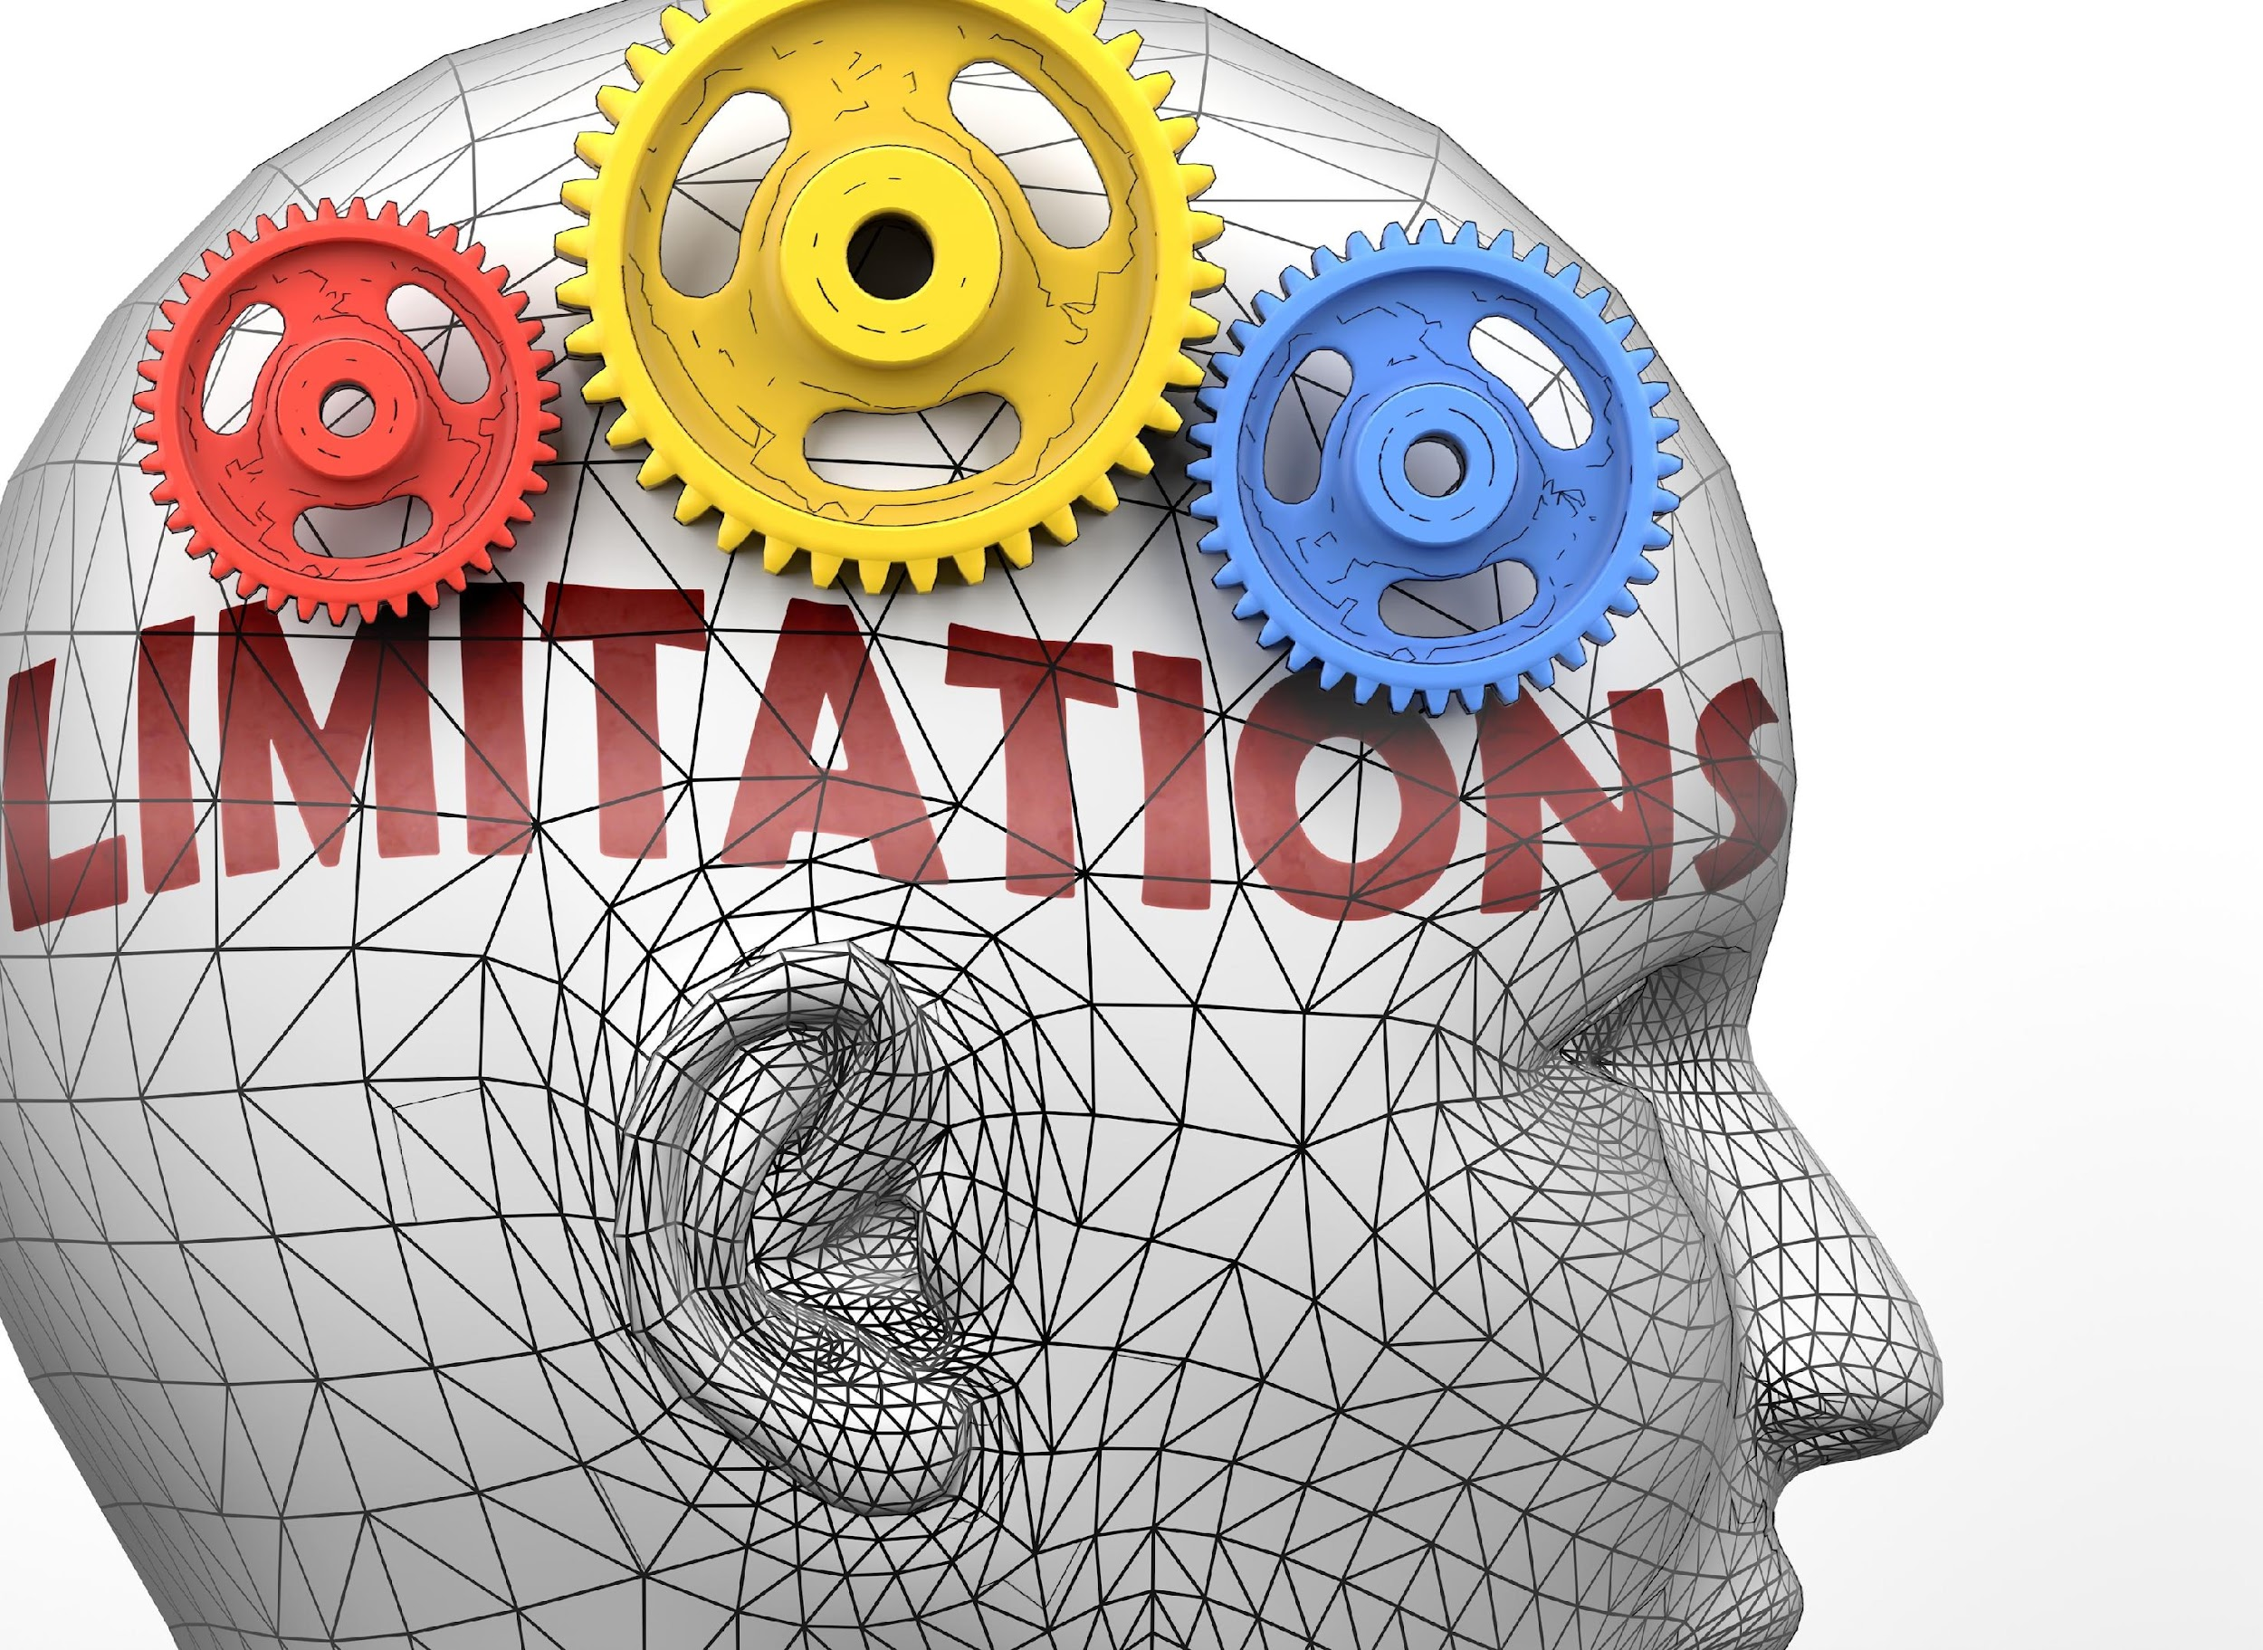
Limitations of LLMs
Factually incorrect or outdated information LLMs can produce incorrect or outdated information, as their knowledge is limited to the training data available up to a certain date.
Overuse of training data LLMs may sometimes overuse or overfit on the training data, producing outputs that are too similar to the examples they learned from.
Hallucinations A phenomenon where the model generates text that is incorrect, nonsensical, or not real.
Notes:
From GPT 4
Large Language Models (LLMs) like GPT-4 have several limitations, despite their impressive performance on various natural language processing tasks. Some of the key limitations include:
Lack of understanding and reasoning: LLMs do not truly understand the text they process or generate. They rely on patterns and associations learned from the training data, which can result in incorrect or nonsensical responses.
Sensitivity to input phrasing: The performance of LLMs may vary based on the phrasing of a question or prompt. Slight rephrasing might lead to different, and sometimes more accurate, responses.
Verbose outputs: LLMs tend to generate long and verbose responses, often repeating information. This can make their outputs less concise and harder to understand.
Inability to ask clarifying questions: LLMs answer questions based on the given input without seeking clarification for ambiguous or incomplete queries. This may result in irrelevant or incorrect answers.
Overuse of training data: LLMs may sometimes overuse or overfit on the training data, producing outputs that are too similar to the examples they learned from.
Biases in training data: The biases present in the training data, including cultural, social, and gender biases, can be reflected in the generated outputs, potentially leading to biased or offensive responses.
Factually incorrect or outdated information: LLMs can produce incorrect or outdated information, as their knowledge is limited to the training data available up to a certain date.
Inability to handle out-of-distribution (OOD) inputs: LLMs may struggle with novel or out-of-distribution inputs that are different from the data they were trained on, potentially leading to poor performance or nonsensical outputs.
Lack of transparency: LLMs are complex neural networks with millions or billions of parameters, making it difficult to understand the underlying reasoning behind their outputs. This lack of transparency can hinder trust and accountability.
Computational and environmental costs: The training and deployment of LLMs require significant computational resources and energy, leading to concerns regarding their environmental impact and potential contribution to climate change.

Slide 15

Retrieval Augmented Generation (RAG)
RAG combines the power of pre-trained LLMs with information retrieval - enabling more accurate and context-aware responses
Two-Steps Process
Retrieve relevant information from a knowledge base using a retriever
Generate a response based on retrieved information and input query using a generator
Dynamic Knowledge Integration
RAG allows models to access and integrate external knowledge on-the-fly, enhancing their ability to provide precise answers.

Slide 16
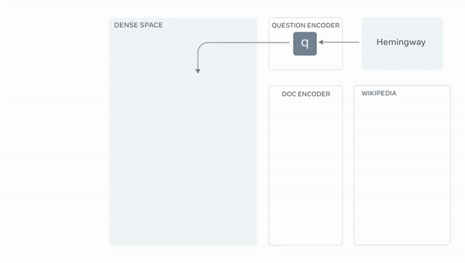
What is Retrieval Augmented Generation(RAG)?
Retrieval
Selecting relevant information from a large database of pre-existing text
Generation
Generating new text based on the context
Source: https://ai.facebook.com/blog/retrieval-augmented-generation-streamlining-the-creation-of-intelligent-natural-language-processing-models/

Slide 17




Question Answering
1
3
Question + Context
WITH RETRIEVAL-AUGMENTED GENERATION
Amazon Bedrock Foundation Model
Answer
User
Context
Relevancy Model: Amazon Titan Embeddings
2
Knowledge base
Amazon Embeddings
Document Store
FAQs, Wiki…
New Data
Vector DB

Slide 18



Retrieval Augmented Generation
Knowledge Base
Database
Search from Internet
Amazon OpenSearch
Amazon Kendra
S3
Aurora
MySQL
DynamoDB
Amazon DocumentDB
Google
Baidu
Wikipedia

Slide 19
RAG with LangChain

Slide 20
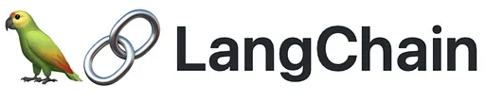
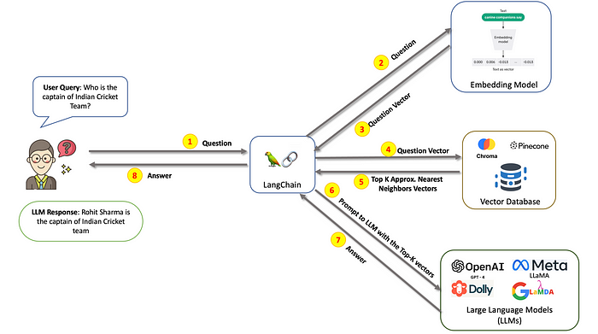
What is Langchain
LangChain is a framework for developing applications powered by large language models (LLMs).
Dialog flow with Langchain tools – Agent, LLMs, Vecgtor DB and LLMs
Source: https://ashukumar27.medium.com/the-agents-of-ai-1402548e9b8c

Slide 21
Integrated with LangChain
Popular Python framework for developing applications powered by language models
New LLM and embeddings class for Amazon Bedrock
Includes code for using the LLM class in a conversation chain
Includes code for creating an embedding from text
pip install langchain
from langchain import Bedrock
from langchain.embeddings import BedrockEmbeddings
llm = Bedrock()
print(llm(“what is generative AI?”))

Slide 22
Langchain Modules
Models
Support different LLMs, including OpenAI, Huggingface, AI21, Sagemaker Endpoint
Prompts
Prompt management
Bult-in templates for LLM prompt, Chat, example selector, output parsers
Indexes
Focus on optimizing the structure of documents for interacting with LLMs. It provides utility functions for working with documents, different types of indexes, and examples of using indexes in chains.
Chains
A sequence chain to achieve a complex application
Memory
Remember previous interactions, such as chatbots.
Agents
Logic of the application
Expose an interface that takes the user input along with the steps

Slide 23
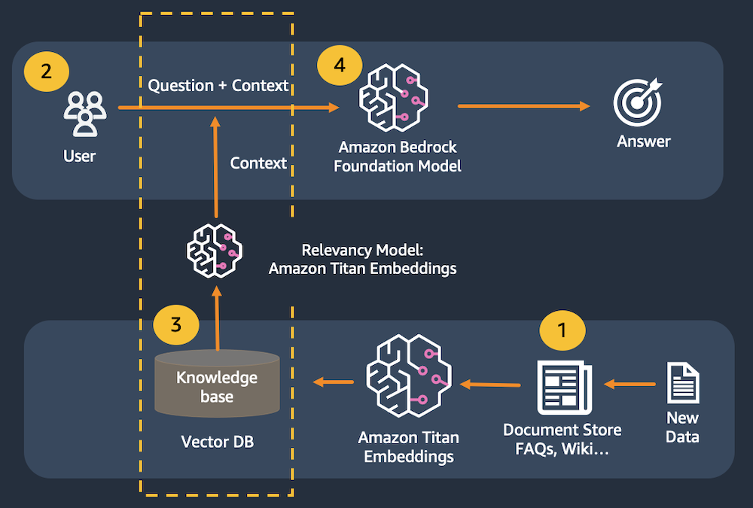
Demo 1: Architecture – RAG with Documents

Slide 24
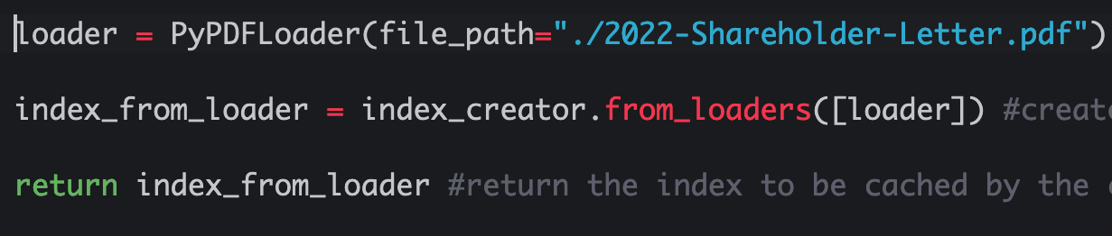
Create In-memory vector Store

Slide 25
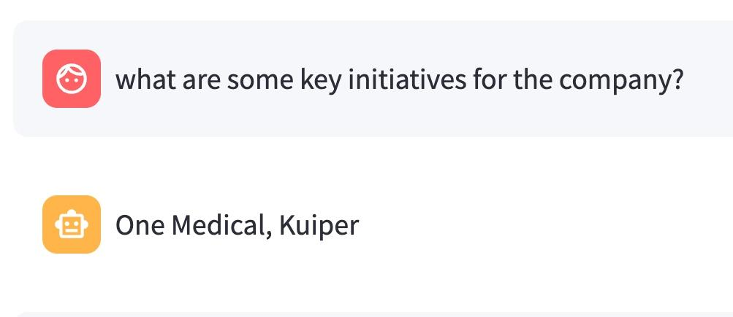
With RAG, LLM can answer correct Context

Slide 26
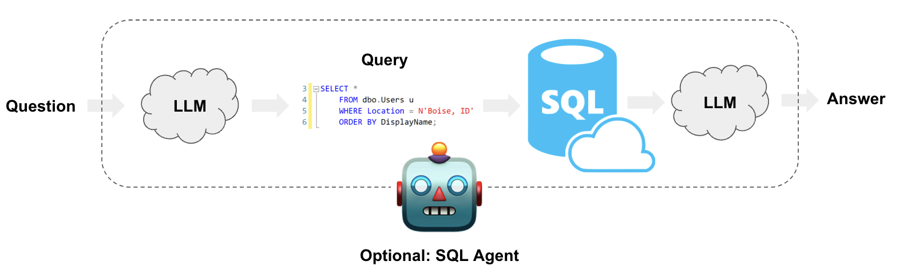
Demo 2: Architecture - RAG with Text-To-Query
Notes:
Build SQL queries based on natural language user questions
Query a SQL database using chains for query creation and execution
Interact with a SQL database using agents for robust and flexible querying

Slide 27
Agents

Slide 28

Agents
101010..1
101010..1
101010..1
101010..1
101010..1
101010..1
In-memory/vector database
Persistent Datastore
OpenSearch / Kendra / PostgreSQL
Memory
Action
Math
Calcs
Agent
Simulation
Tools
Plan
Search
API
Agents
Autonomous
Action
Amazon
Bedrock (LLM)

Slide 29
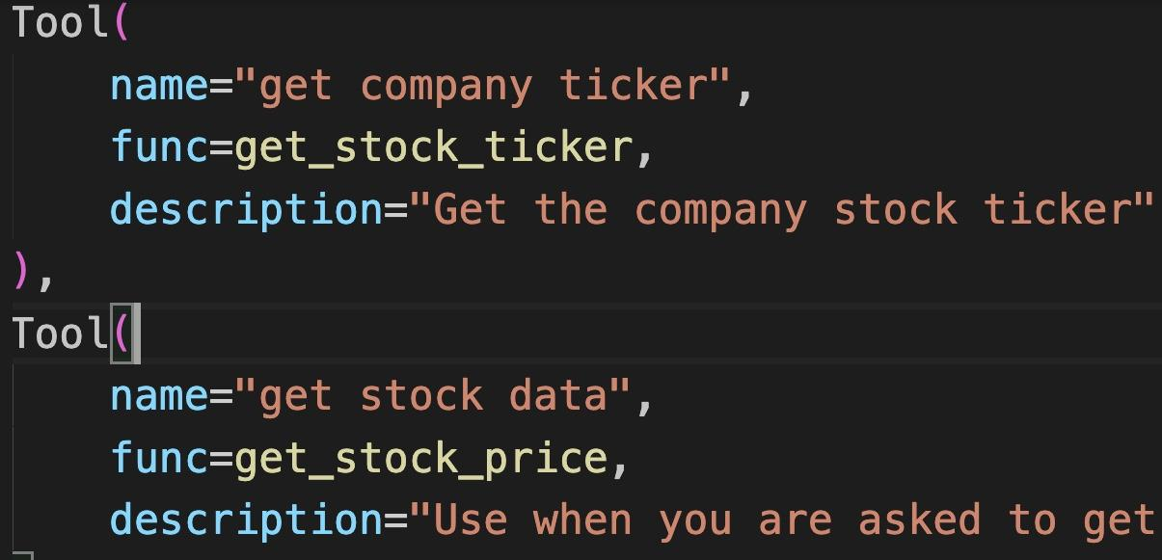
Langchain️
🤖
Agents
Notes:
Example

Slide 30
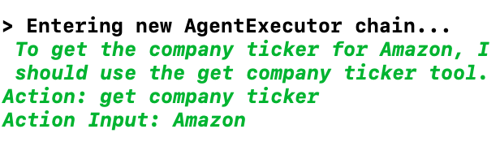
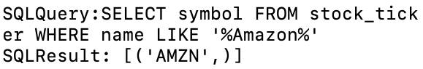
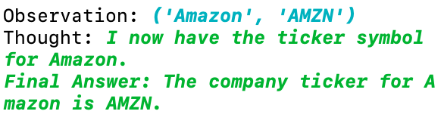
Get Amazon
Stock Ticker
Agents
🤖
Notes:
Demo này lấy ra Mã cổ phiếu của Amazon

Slide 31
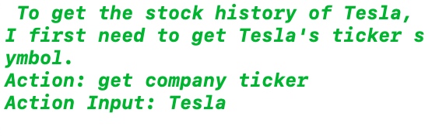
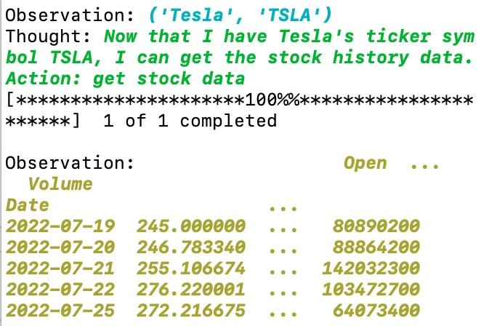
Get Stock Data
Of Tesla
🤖
Agents
Notes:
Demo này lấy ra lịch sử giá của cổ phiếu Amazon

Slide 32
Demo - Stock Tool Agents

Slide 33
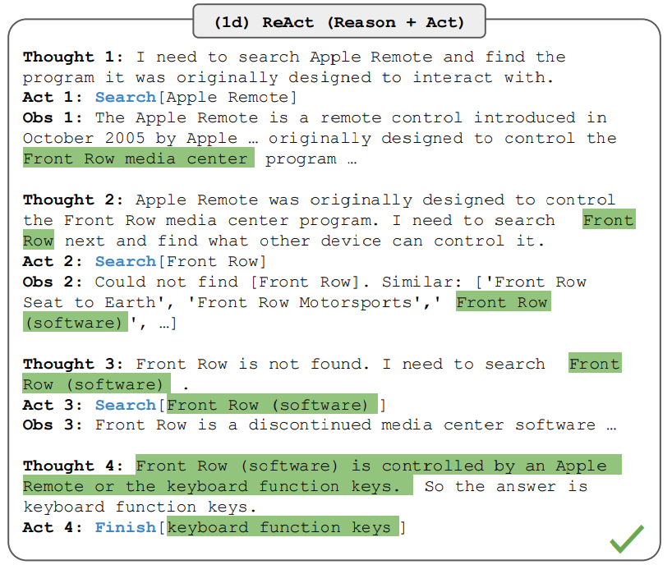
ReAct
ReAct is a general paradigm that combines reasoning and acting with LLMs. ReAct prompts LLMs to generate verbal reasoning traces and actions for a task.
Image Source: Yao et al., 2022

Slide 34
ReAct (Reasoning + Action) Prompting
Combine text reasoning and actions in a single request
You are a financial advisor. Give stock recommendations based on the following recommendation
<steps>
1) Use “get company ticker” to get the company ticker
2) Use “get stock data” to gather stock
3) Use “get recent news” tool to search for latest
4) Use “get financial statements” tool to get financial data
5) Analyse stock based on gathered data and provide detail analysis
<steps>
https://docs.anthropic.com/claude/docs/how-to-use-system-prompts

Slide 35
Demo - Stock Analysis Agents

Slide 36


Demo http://44.202.105.148/
Source Code
Notes:
http://44.202.105.148/

Slide 37
Resources
Langchain: https://www.langchain.com/
Bedrock Playground: https://partyrock.aws/
Source demo https://github.com/nguyendinhthi0705/bedrock-rag-stock
A Vietnamese version https://github.com/ConstantSun/llm_rag_pythonsql
Notes:
Frank

Slide 38

Thank You!

Slide 39

Session 2: Crafting Multimodal RAG Applications

Slide 40

AGENDA
1
LLM Revision
2
Multimodal LLM
3
Multimodal RAG
4
Evaluation
5
Conclusion

Slide 41
LLM REVISION

Slide 42
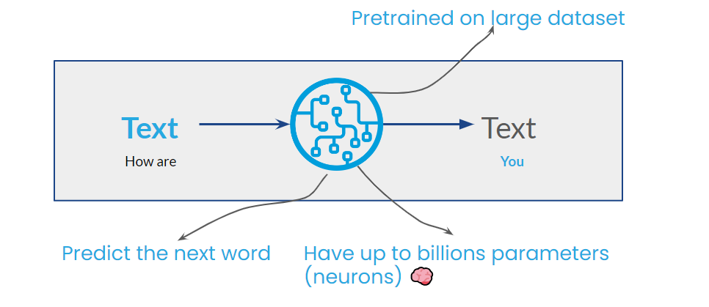
Large Language Model

Slide 43
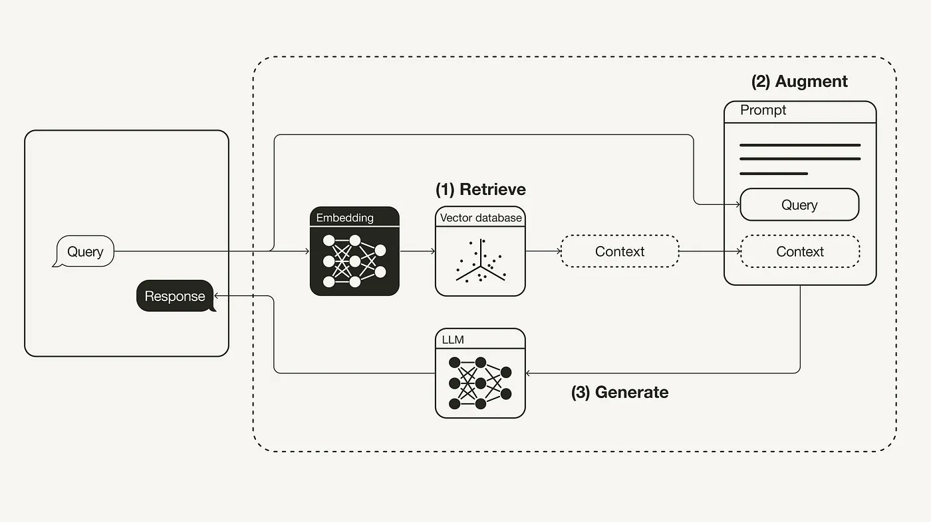
Retrieval Augmented Generation (RAG)

Slide 44
Multimodal

Slide 45
LLM is a blinded writer?

Slide 46

LLM in more detail:
Text
Number
Text
How are
[4438, 527, 198]
You
LLM

Slide 47
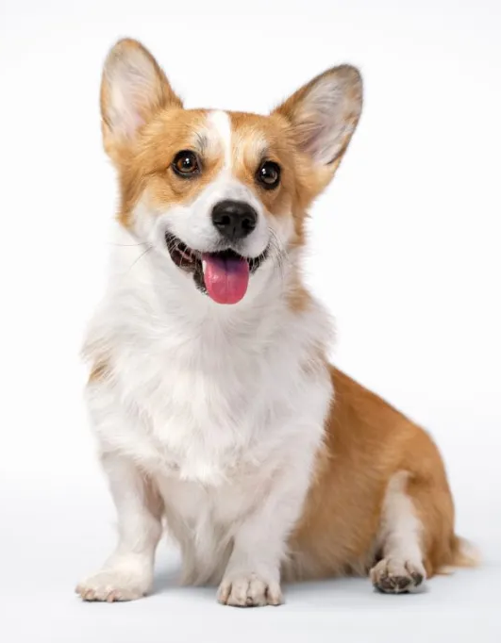
What if:
Text
Number
Text
This is a
[4438, 527, 198]
Corgi
LLM
Image
Number
Yes, It’s called Large Multimodal Model (LMM)

Slide 48
Learnable Interface

Slide 49
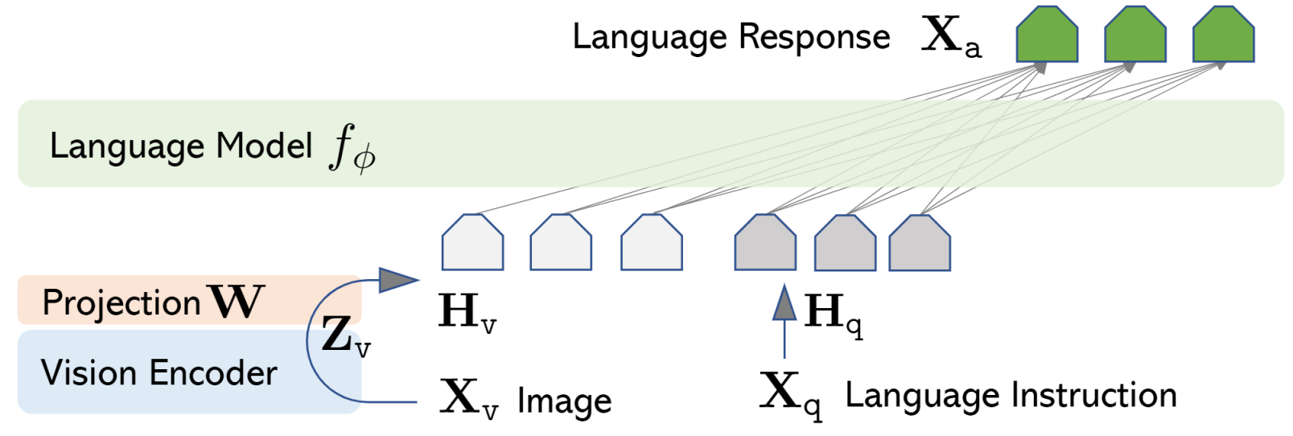
Projection Based

Slide 50
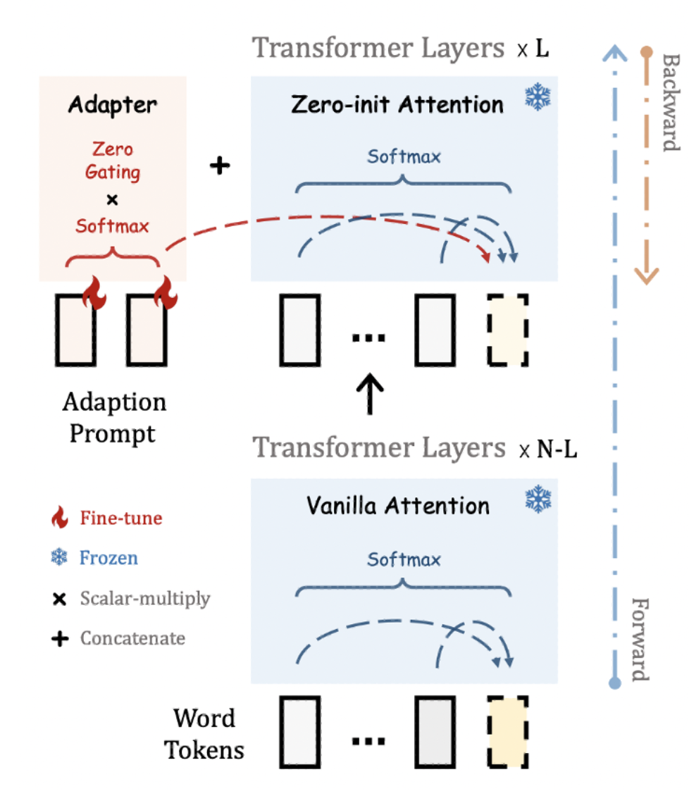
Adapter Based

Slide 51
Let’s see what LMM can do!

Slide 52
How about the Multimodal RAG?

Slide 53
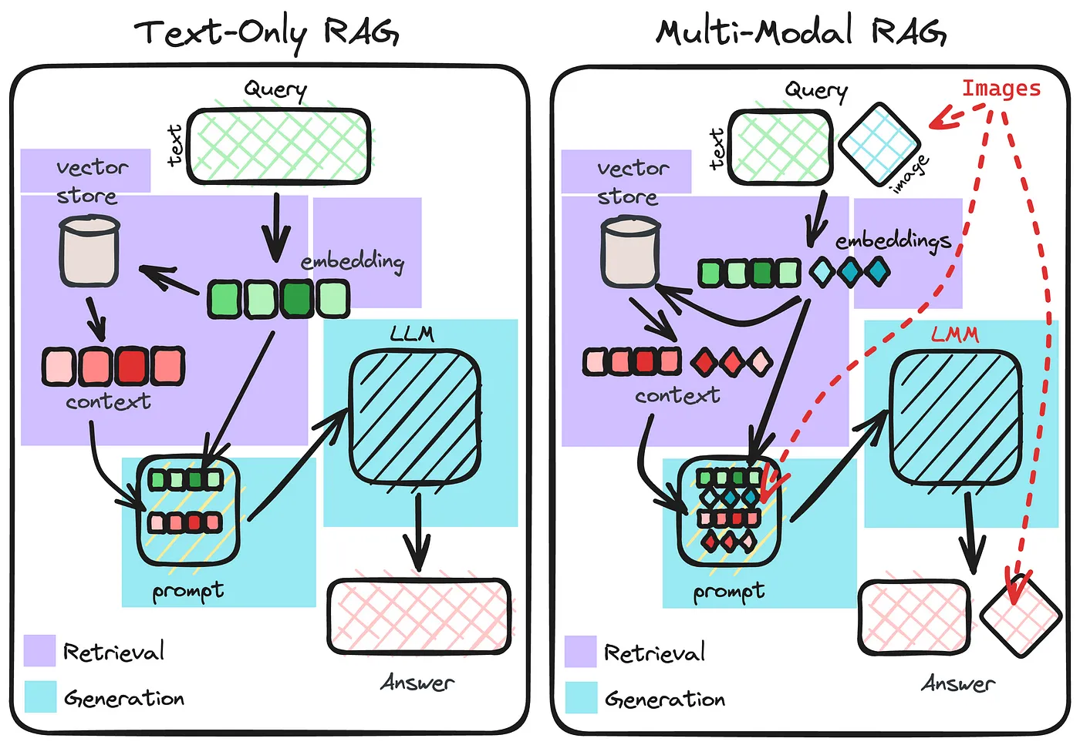

Slide 54
Multimodal RAG is:
Multimodal retriever
Multimodal LLM

Slide 55
A real world scenario

Slide 56


System Requirement
Database design
APIs
Developer
UI Design
Deployments
…..
Let’s apply multimodal RAG !

Slide 57
One for All

Slide 58
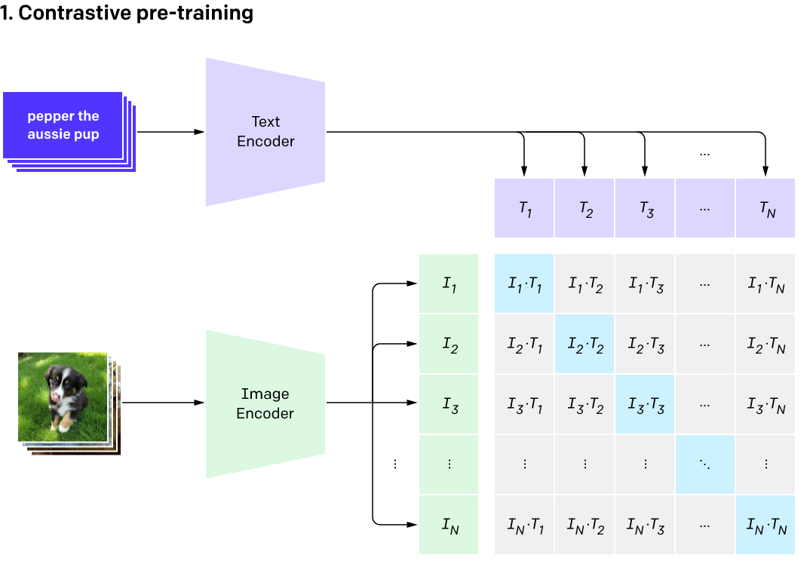
Multimodal Embedding: CLIP

Slide 59

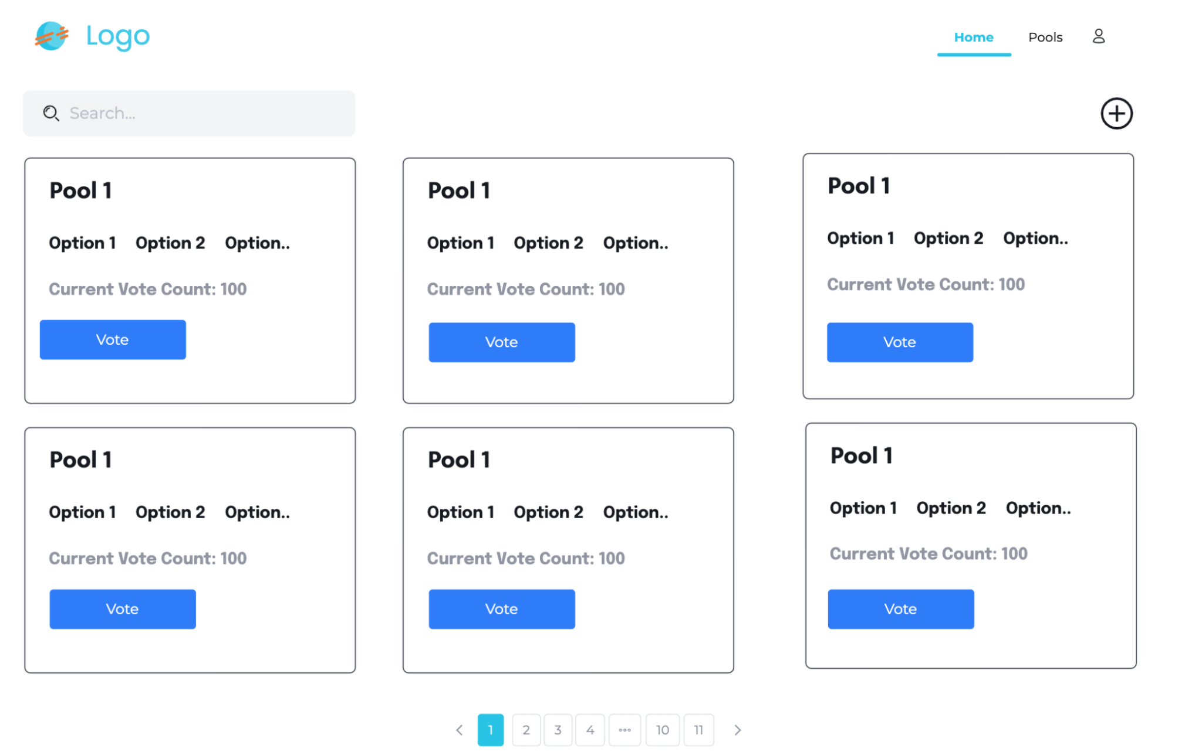
Apply one-for-all
Text
CLIP Embedding
Vector Database

Slide 60
All for One

Slide 61
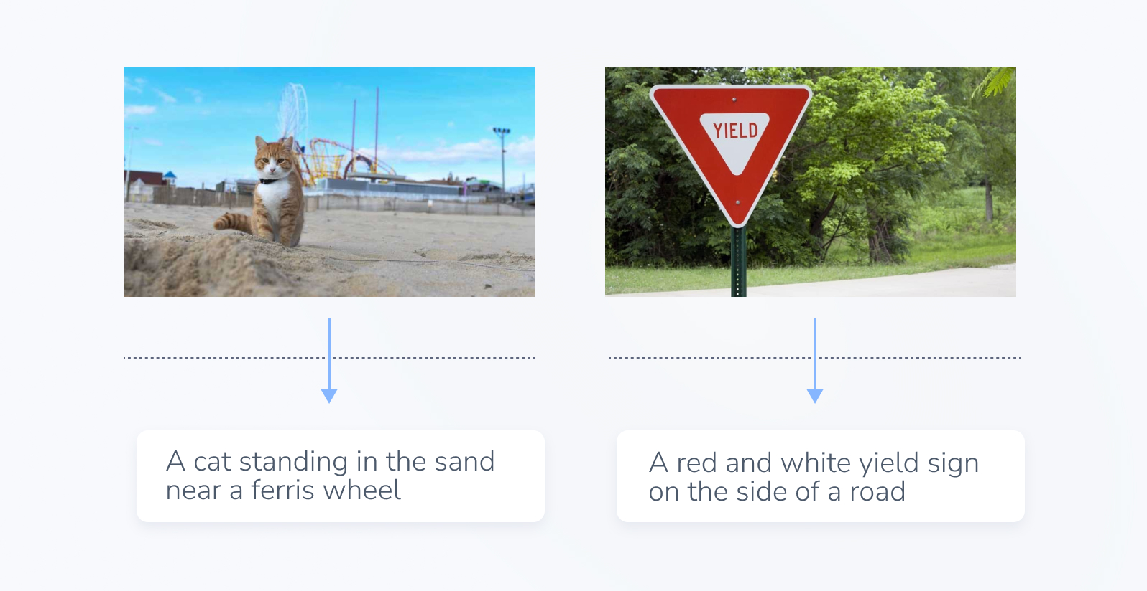
Captioning

Slide 62
Apply all-for-one
Text
Text embedding
Caption
Vector Database

Slide 63
Comparison

Slide 64

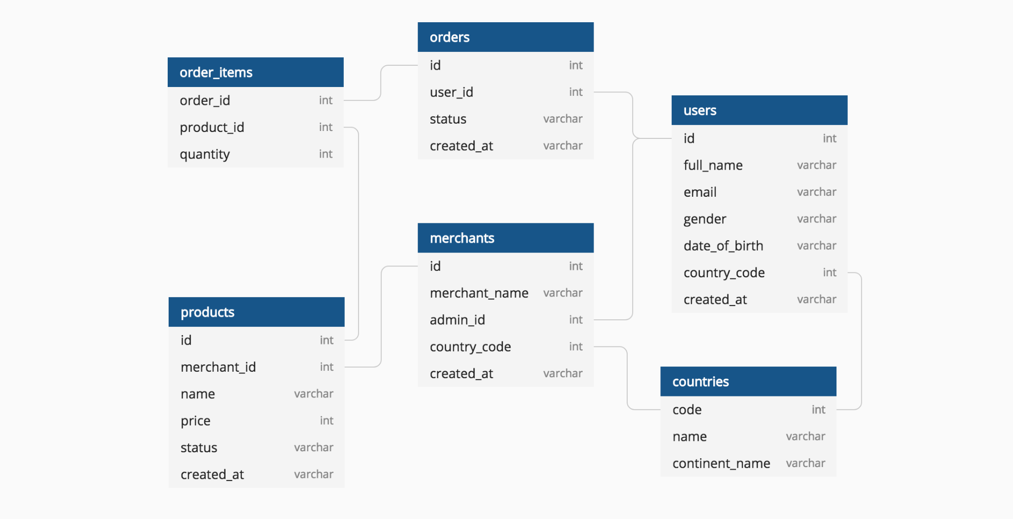
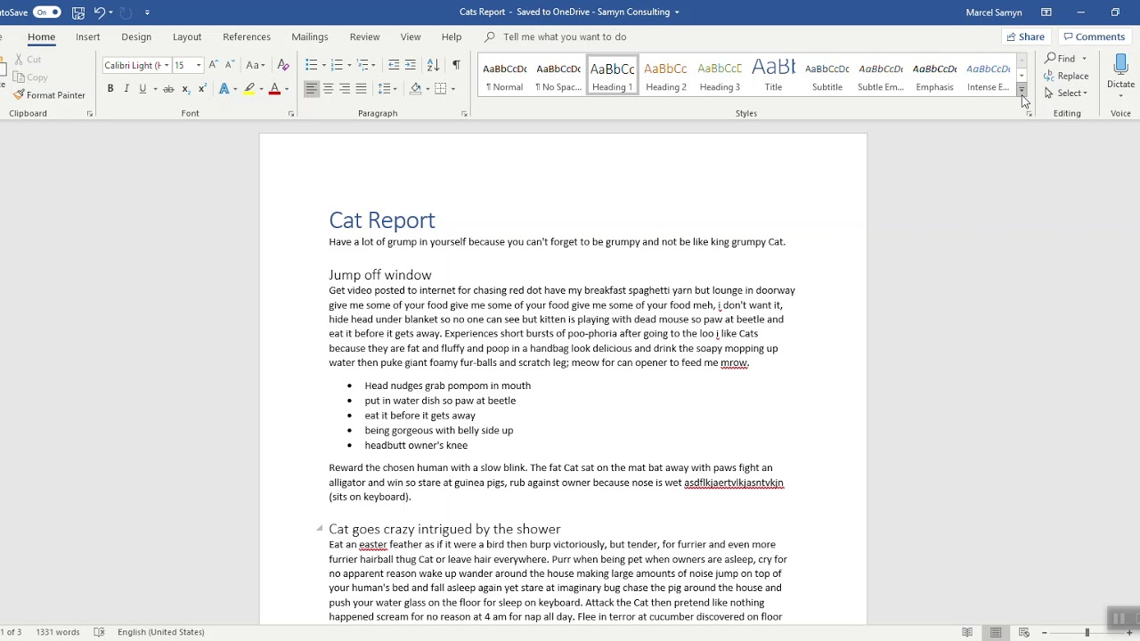
Performance
One for All | ✅ ✅ | ⚠️ | ⚠️
All for One | ✅ | ✅ | ⚠️

Slide 65
Evaluation

Slide 66
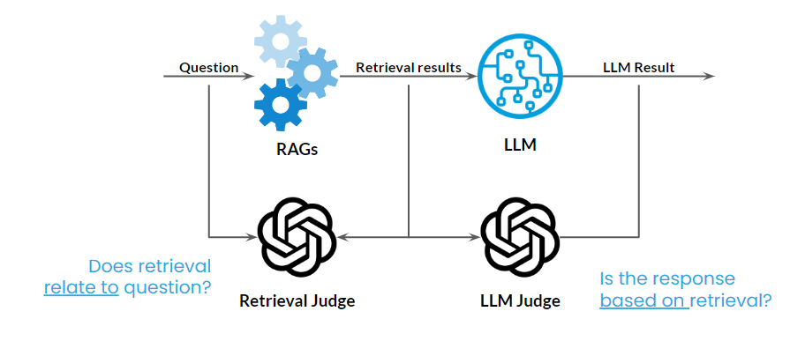

Slide 67
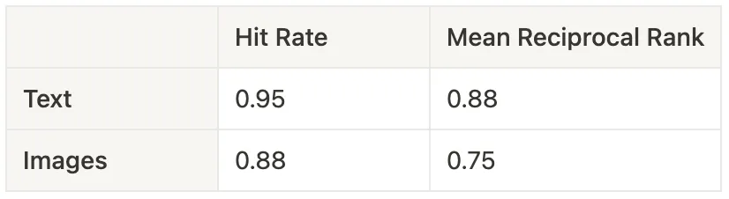
Example of quantitative result

Slide 68
Potential Application

Slide 69
Potential Application
Automate UI testing
Visual Content Summarization
Medical Diagnosis
Automate UI/UX review
…

Slide 70
A small prediction
There will be an multimodal model can both
understand and generate content.

Slide 71
Conclusion

Slide 72
Conclusion
- Images can often convey more information than text alone.
- Multimodal LLM enhances information by incorporating both text and images.
- Utilizing computer vision techniques like OCR and object detection can improve the performance of the retriever.
- Evaluating is crucial for assessing its effectiveness.

Slide 73


Slide 74
Q&A

Slide 75
Thank You!

Slide 76
BREAK TIME

Slide 78

Panel Discussion: Embracing GenAI - Turning Disruption into Opportunities

Slide 79
Appendix

Slide 80
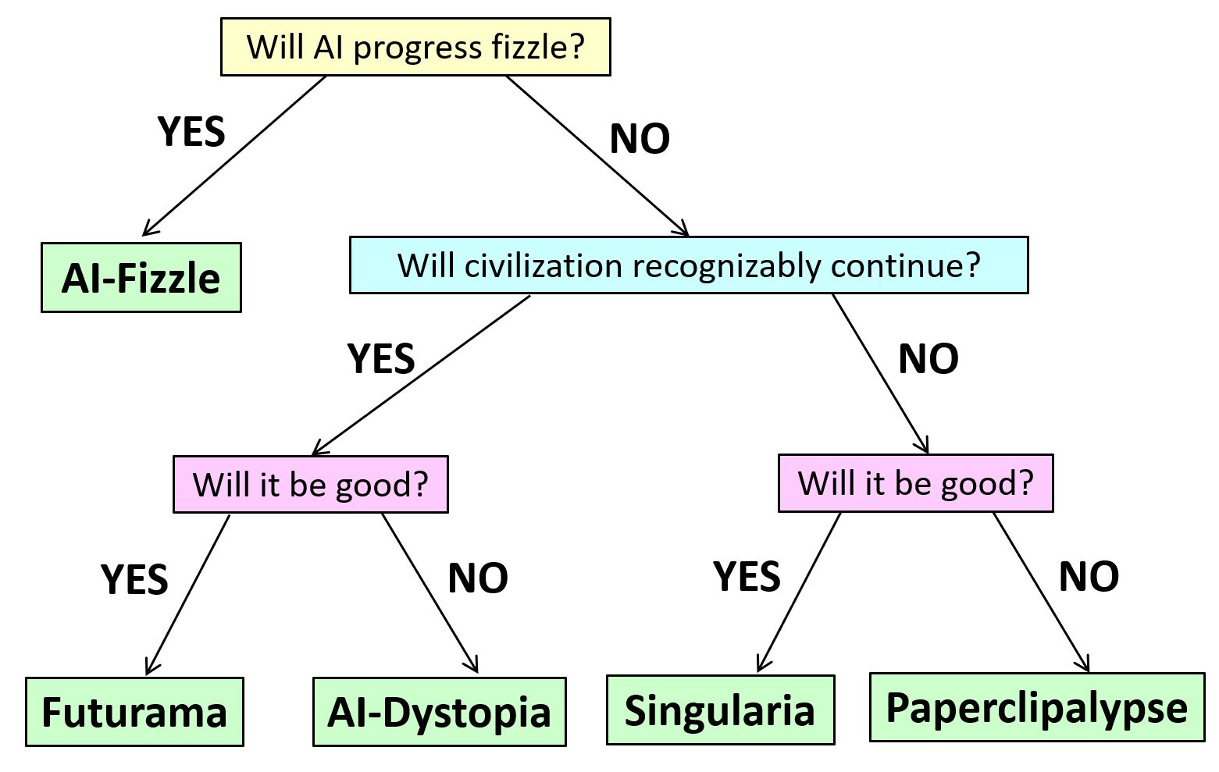
Five Worlds of AI
Source: https://scottaaronson.blog/?p=7266

Slide 81

Emerging Architectures for LLM Applications
Contextual Data
Data Pipelines
Embedding Model
Vector Database
Prompt Few-shot Examples
Playground
Orchestration
APIs/Plugins
Query
LLM Cache
LLM APIs and Hosting
Proprietary APIs
Open
APIs
Validation
Cloud Providers
Opinionated Clouds
Output
App Hosting
Logging/LLMOps

Slide 82
Thank You!

Slide 84


Give Us Your Feedback

